Slide 1
Intelligent Crop Disease Monitoring & Management

Slide 2
Problem Statement with major challenges
Crop Issues
The disease can be caused due to the bacteria's, viruses, and fungi affecting the crop both above and below the ground.
The main challenge in smart farming is to control plant diseases to a great extent.
The food crops which are consumed daily are mainly affected by crop diseases.
The crop diseases are identified by the yellowing of margins, lesions and spot formation of any color.
Damage
The damage is identified by the amount of chlorophyll present in the leaves.
If the leaves color changes from its original color to somewhat else, then the leaf is identified to be damaged.

Slide 3
Problem Statement with major challenges
Nutrient Deficiency and Toxicity
Nutrient deficiency and toxicity in the soil lead to diseased crops. A plant is said to be nutrient deficient if the nutrients such as Phosphorous, Potassium, Sulphur, Zinc, Iron, Calcium, Magnesium, etc. If a plant is nutrient deficient it possesses the following symptoms.
Stunting: The crops growth is decreased to a great extent
Necrosis: This results in the death of the plant
Inerveinal Chlorosis: Yellowing in the green leaves
Generalized: The symptoms are shown in the plant asthe whole
Burning: The leaves show a burning appearance

Slide 4
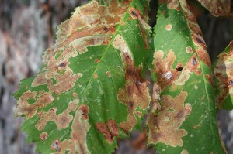
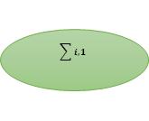
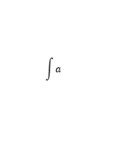
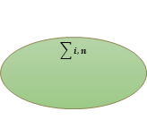
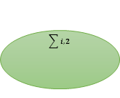
Methodology
Input Image
Identified Problem
Input Layer
a_{i,1}
…….
a_{i,n}
$$\sum{i,1}$$
$$\sum{i,2}$$
……
$$\sum{i,n}$$
$$\int{a}$$
Activation Function
f_{i,1}
f_{i,2}
…..
f_{i,n}
Hidden Layer
Output
Layer
…………………………………
Fire Blight
99.9%
Disease Name
Accuracy

Slide 5
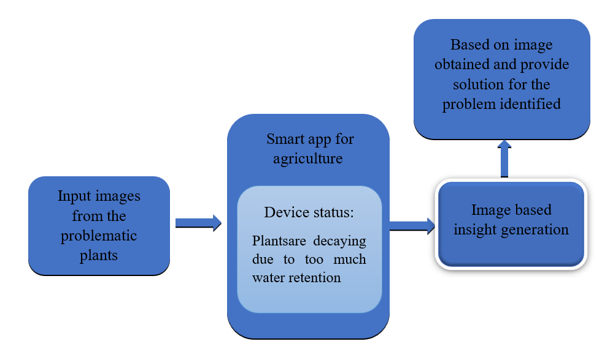
Methodology

Slide 6
Cost Split up
Sl.No. | Item | Cost
1
2
3
4
5
Total

Slide 7
Phases of Project
Sl. No. | Milestone | 1-2 months |  |  |  | 3-4 months |  |  |  | 5-6 months
1.
2.
3.
4.
5.
6.
7.
8.

Slide 8
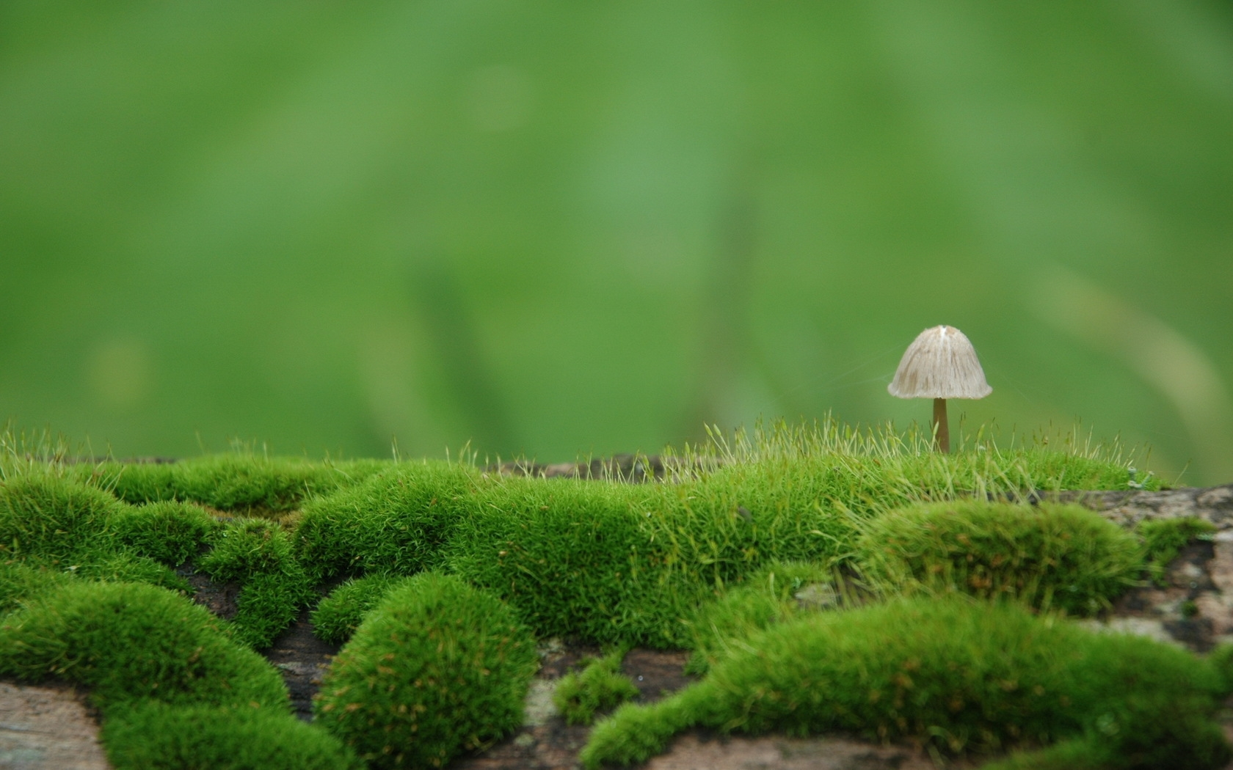
THANK YOU

